Slide 1


CMPE 180-92 Data Structures and Algorithms in C++ February 2 Class Meeting
Department of Computer Engineering San Jose State University Spring 2017 Instructor: Ron Mak
www.cs.sjsu.edu/~mak

Slide 2
Basic Info
Office hours
Th 2:30 – 4:30 PM
ENG 250
Website
Faculty webpage: http://www.cs.sjsu.edu/~mak/
Class webpage: http://www.cs.sjsu.edu/~mak/CMPE180-92/
Green sheet
Assignments
Lecture notes

Slide 3
Assignment #1: Sample Solution
First start with a “draft” of your program.
Test that you can read the individual fields of the input file.
Then incrementally add to the draft until you have the complete solution.
Always build on working code.
Do not attempt to write an entire program all at once and then try to get it to work.

Slide 4
Predefined Functions
C++ includes predefined functions.
AKA “built-in” functions
Example: Math function sqrt
Predefined functions are stored in libraries.
Your program will need to include the appropriate library header files to enable the compiler to recognize the names of the predefined functions.
Example: #include <cmath> in order to use predefined math functions like sqrt

Slide 5
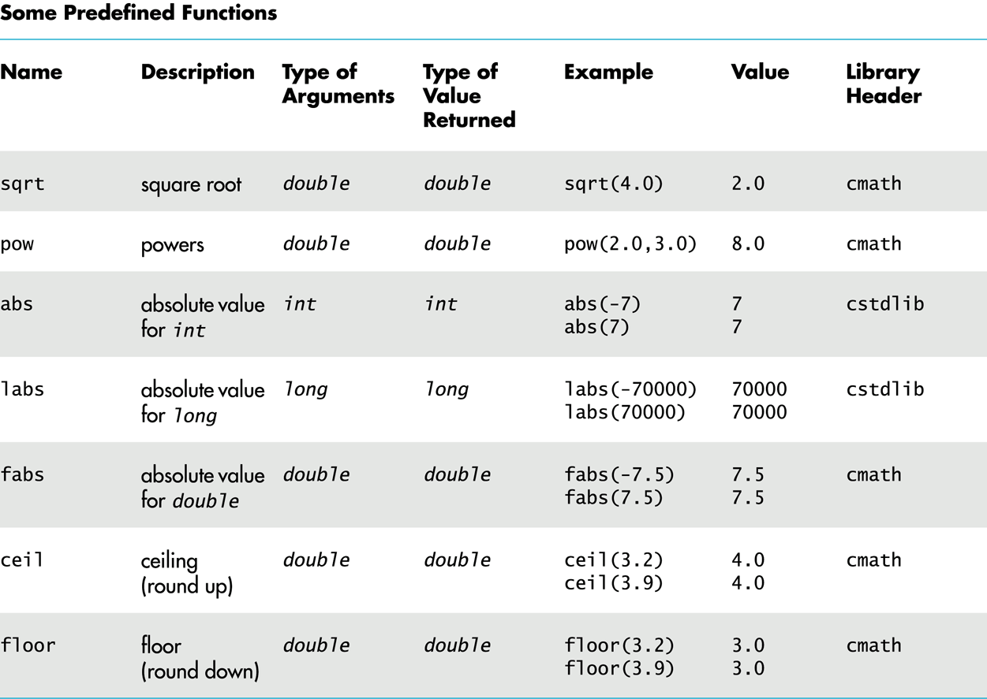
Predefined Functions, cont’d
Savitch_ch_04.ppt: slides 8 – 12, 72

Slide 6
Random Numbers
To generate (pseudo-) random numbers using the predefined functions, first include two library header files:
“Seed” the random number generator:
If you don’t seed, you’ll always get the same “random” sequence.
#include <cstdlib>
#include <ctime>
srand(time(0));

Slide 7
Random Numbers, cont’d
Each subsequent call returns a “random” number ≥ 0 and < RAND_MAX.
Use + and % to scale to a desired number range.
Example: Each execution of the expression returns a random number with the value 1, 2, 3, 4, 5, or 6.
rand();
rand()%6 + 1

Slide 8
Type Casting
Suppose integer variables i and j are initialized to 5 and 2, respectively.
What is the value of the division i/j ?
What if we wanted to have a quotient of type double?
We want to keep the fraction.

Slide 9
Type Casting, cont’d
One way is to convert one of the operands (say i) to double.
Then the quotient will be type double.
Why won’t the following work?
double quotient = static_cast<double>(i)/j;
double quotient = static_cast<double>(i/j);

Slide 10
Programmer-Defined Functions
In addition to using the predefined functions, you can write your own functions.
Programmer-defined functions are critical for good program design.
In your C++ program, you can call a programmer-defined function only after the function has been declared or defined.

Slide 11
Function Declarations
A function declaration specifies:
The function name.
The number, order, and data types of its formal parameters.
The data type of its return value.
Example:
double total_cost(double unit_cost, int count);

Slide 12
Function Definitions
After you’ve declared a function, you must define it.
Write the code that is executed whenever the function is called.
A return statement terminates execution of the function and returns a value to the caller.
Example:
double total_cost(double unit_cost, int count)
{
double total = count*unit_cost;
return total;
}

Slide 13
Function Calls
Call a function that you wrote just as you would call a predefined function.
Example:
int how_many;
double how_much;
double spent;
how_many = 5;
how_much = 29.99;
spent = total_cost(how_much, how_many);

Slide 14
Void Functions
A void function performs some task but does not return a value.
Therefore, its return statement terminates the function execution but does not include a value.
A return statement is not necessary for a void function if the function terminates “naturally” after it finishes executing the last statement.
Example void function definition:
void print_TF(bool b)
{
if (b) cout << "T";
else cout << "F";
}

Slide 15
Void Functions, cont’d
A call to a void function cannot be part of an expression, since the function doesn’t return a value.
Instead, call a void function as a statement by itself.
Example:
bool flag = true;
print_TF(flag);

Slide 16
Top-Down Design
Top-down design is an important software engineering principle.
Start with the topmost subproblem of a programming problem.
Write a function for solving the topmost subproblem.
Break each subproblem into smaller subproblems.
Write a function to solve each subproblem.
AKA stepwise refinement

Slide 17
Top-Down Design Example
Write a program that inputs from the user that are positive integer values less than 1000.
Translate the value into words.
Example:
The user enters 482
The program writes “four hundred eighty-two”
Repeat until the user enters a value ≤ 0.

Slide 18
Top-Down Design Example, cont’d
What is the topmost problem?
Read numbers entered by the user until the user enters a value ≤ 0.
Translate each number to words.
How to translate a number into words?
Break the number into separate digits.
Translate the digits into words such as one, two, ..., ten, eleven, twelve, ..., twenty, thirty, etc.

Slide 19
Refinement 1
Loop to read and print the numbers.
Call a translate function, but it doesn’t do anything yet.

Slide 20
A Convention for Functions
Put function declarations before the main.
If you give your functions good names, the declarations show the structure of your program.
Put function definitions after the main.

Slide 21
Refinement 2
Refine the translate function to handle some simple cases:
translateOnes: 1 through 9
translateTeens: 11 through 19

Slide 22
Refinement 3
The translate function takes a 3-digit number and separates out the hundreds digit.
Translate the hundreds digit and append the word hundred.
Translate the last two digits:
We can already translate a teens number.
Otherwise, break apart the two digits into a tens digit and a ones digit.
translateTens: 10, 20, 30, ..., 90
We can already translate a ones digit.

Slide 23
Refinement 4
Add a hyphen between twenty, thirty, etc. and a ones word.

Slide 24
Refinement 5
Break a 6-digit number into a 3-digit first part and a 3-digit second part.
Translate the first part and append the word thousand.
Translate the second part.

Slide 25
Break

Slide 26
Scope and Local Variables
Any variable declared inside a function is local to that function.
The scope of the variable is that function.
The variable is not accessible from outside the function.
A variable with the same name declared inside another function is a different variable.
The same is true for any variable declared inside the main function.

Slide 27
Block Scope
You can declare variables inside of a block.
A block of code is delimited by { and }.
The variables are local to the block.

Slide 28
Global Constants and Variables
If a constant or a variable is declared outside of and before the main and the function definitions, then that constant or variable is accessible by the main and any function.
Global variables are not recommended.

Slide 29
Overloading Function Names
A function is characterized by both its name and its parameters.
Number and data types of the formal parameters.
You can overload a function name by defining another function with the same name but different parameters.
When you call a function with that name, the arguments of the call determine which function you mean.

Slide 30
Overloading Function Names, cont’d
Example declarations:
Example calls:
Be careful with automatic type conversions of arguments when overloading function names.
See the Savitch text and slides.
double average(double n1, double n2);
double average(double n1, double n2, double n3);
double avg2 = average(x, y);
double avg3 = average(x, y, z);

Slide 31
Call-by-Value
By default, arguments to a function are passed by value.
A copy of the argument’s value is passed to the function.
Any changes that the function makes to the parameters do not affect the calling arguments.
Example: The faulty swap function.

Slide 32
Call-by-Value, cont’d
void swap(int a, int b)
{
int temp = a;
a = b;
b = temp;
}
Why doesn’t this function do what was intended?

Slide 33
Call-by-Reference
If you want the function to be able to change the value of the caller’s arguments, you must use call-by-reference.
The address of the actual argument is passed to the function.
Example: The proper exchange function.

Slide 34
Call-by-Reference, cont’d
void exchange(int& a, int& b)
{
int temp = a;
a = b;
b = temp;
}
Why is this code better?
void exchange(int& a, int& b)

Slide 35
Procedural Abstraction
Design your function such that the caller does not need to know how you implemented it.
The function is a “black box”.

Slide 36
Procedural Abstraction, cont’d
The function’s name, its formal parameters, and your comments should be sufficient for the caller.
Preconditions: What must be true when the function is called.
Postconditions: What will be true after the function completes its execution.

Slide 37
Testing and Debugging Functions
There are various techniques to test and debug functions.
You can add temporary cout statements in your functions to print the values of local variables to help you determine what the function is doing.
With the Eclipse or the NetBeans IDE, you can set breakpoints, watch variables, etc.

Slide 38
assert
Use the assert macro during development to check that a function’s preconditions hold.
You must first #include <cassert>
Example:
Later, when you are sure that your program is debugged and you are going into production, you can logically remove all the asserts by defining NDEBUG before the include:
assert(y != 0);
quotient = x/y;
#define NDEBUG
#include <cassert>

Slide 39
Assignment #2: Rock Paper Scissors
Practice decomposing a program by using functions.
Write a program where a human plays Rock Paper Scissors with the computer.
Rock beats scissors.
Paper beats rock.
Scissors beats paper.
Each round:
Prompt the human to enter a choice.
The computer randomly chooses.

Slide 40
Rock Paper Scissors, cont’d
At the end of each round, record whether the human player won, the computer won, or it was a tie.
At the end of the game, print how many times the human won, how many times the computer won, and how many times it was a tie.

Slide 41
Week 2 Practice Problems
Look for practice problems in Canvas.
They should appear in a day or two.
Hope that the auto-scoring feature is working.
It was a security certificate problem.

